Slide 1


Prediction Model for Students’ Future Development
Using Deep Learning and Tensor flow AI Engine
Team Members :
Muhammed Fairoos M
Sahad K
Nishad K
Guided By :
Sufyan P

Slide 2
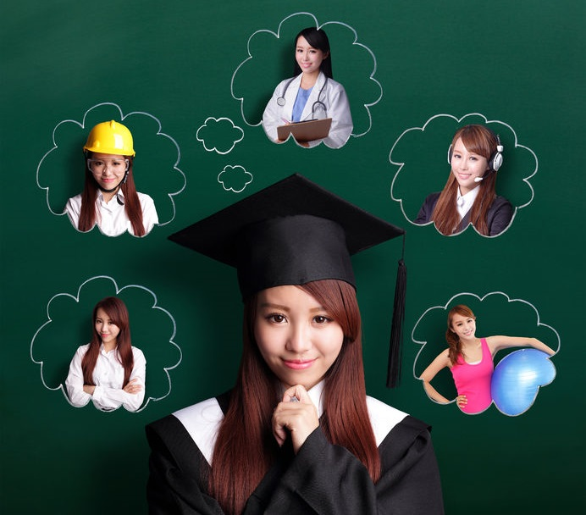
Introduction
Classification and prediction of students’ performance in examination are the typical challenges for educators.
Various traditional data mining methods such as decision tree and association rules were used to perform classification.
In this paper, a research on how to use Tensor flow AI engine for classifying students’ performance and forecasting their future universities degree program is studied.

Slide 3
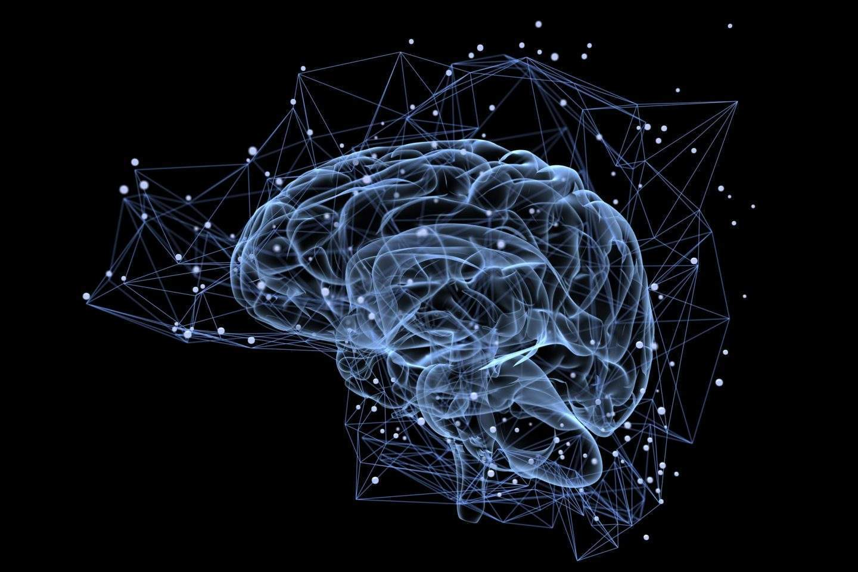
Objective
In order to build the predictive modeling, there are several traditional tasks used for example classification, regression and categorization.
Algorithm such as association rules and decision tree are commonly used.
An appropriate and accurate forecast is important for providing prompt advice to student on program and university selection.
For a more comprehensive consideration of an all rounded factors, the deep learning model analyzed not only the traditional academic performance but also non-academic performance.

Slide 4
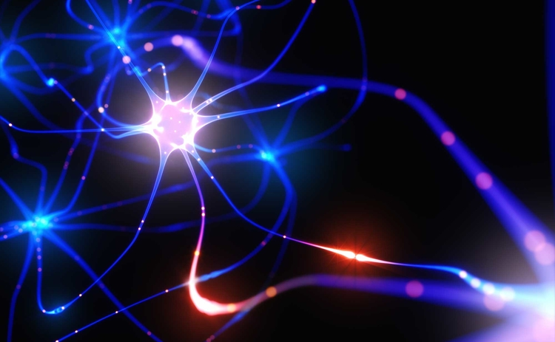
Scope
Classification and prediction is a general problem.
Classification and prediction is a general problem.
Traditional data mining techniques such as association rules, decision tree, clustering and so on had been use for a few decades for solving this problem.
The raising popularity of using Tensorflow for deep learning and artificial intelligence opened a new approach and direction for solving classification problem and prediction of non-linear results.
The prediction result is good enough to provide appropriate recommendations for students, their teachers and parents to decide their development pathway.

Slide 5
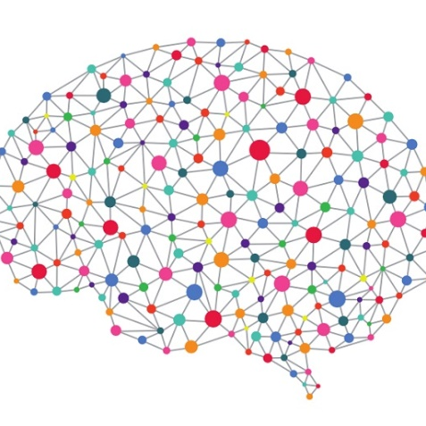

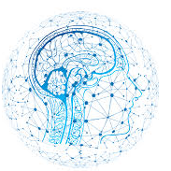
Technologies Used
Deep Learning
Tensor Flow
AI
Deep learning is a subset of ML in AI that has networks capable of learning unsupervised from data that is unstructured or unlabeled.
Tensor Flow is a free and open-source software library for dataflow and differentiable programming across a range of tasks.
Artificial intelligence (AI) is the simulation of human intelligence processes by machines, especially computer systems.

Slide 6

Conclusion
This study demonstrated that deep learning could be an effective tool for predicting the students’ performance
The result ranged from 80% to 91%.
The prediction result is good enough to provide appropriate recommendations for students, their teachers and parents to decide their development pathway.
It is believed that more applications of deep learning could be used for education and corporate staff training in the future.

Slide 7
References
Wikipedia
Wilton W.T. Fok1, Y.S. He1, H.H. Au Yeung1, K.Y. Law1, KH Cheung1, YY. Ai1, P. Ho1 "Prediction Model for Students’ Future Development by Deep Learning and Tensorflow Artificial Intelligence Engine",2018

Slide 8

Thank You

